Slide 1

NCAA Compliance
2026-27

Slide 2

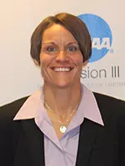

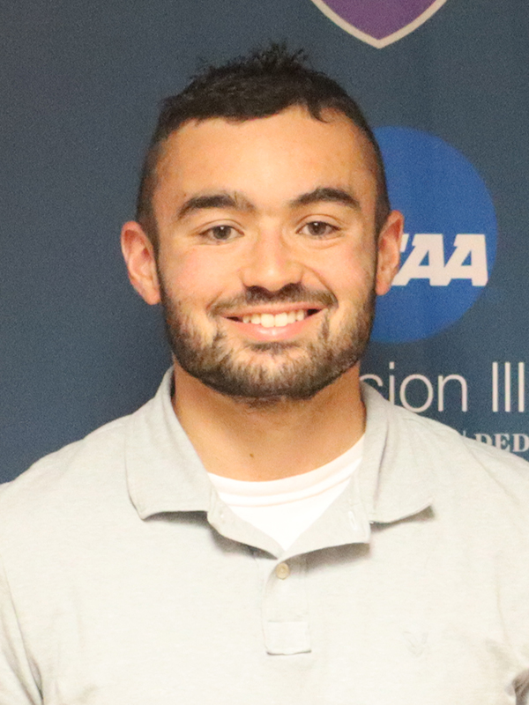
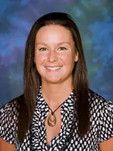
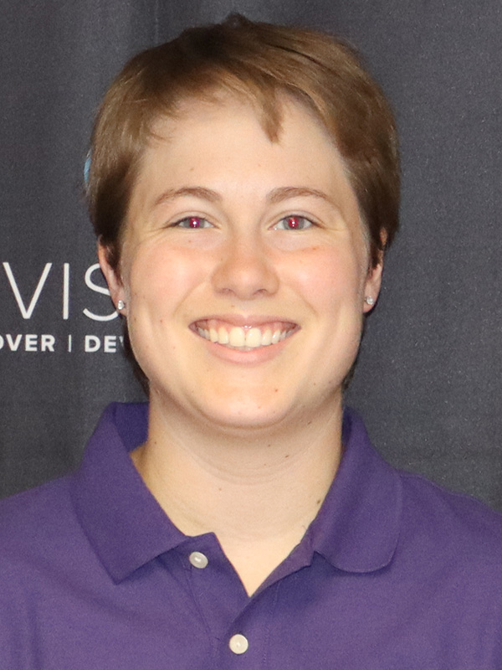
Athletic Department Staffing
Jess Stanek
Brian Vanden Acker
Mike Rampe
Director of Athletics
Associate Director of Athletics
Compliance and Eligibility
Sports Information Director
Holli Hall
Grace Steins
Director of Sports Medicine
Assistant Athletic Trainer

Slide 3

Eligibility
Must be enrolled full-time at all times (12 credit hours)
  If you are considering dropping a class, talk to Brian or Jess prior or you will be immediately ineligible
  Should be in 15-16 credits each semester; 124 total credits to graduate
Must be in good academic standing
  Academic Standards for all athletes (Returners, freshman, or transfers) need to remain in good academic standing. To remain in good academic standing, Rockford University students must maintain the following cumulative grade point averages.
    First-Year (0-29.5 credit hours earned) 1.80
    Sophomores (30-59.5 credit hours earned) 1.90
    Juniors and Seniors (60 or more credit hours earned) 2.00
10 full-time semesters to compete in 4 seasons
  Use a season once you continue to practice beyond the first date of competition or participated in the first day of competition
  No redshirting in Division III
    Medical hardship is only way to possibly get your season back

Slide 4
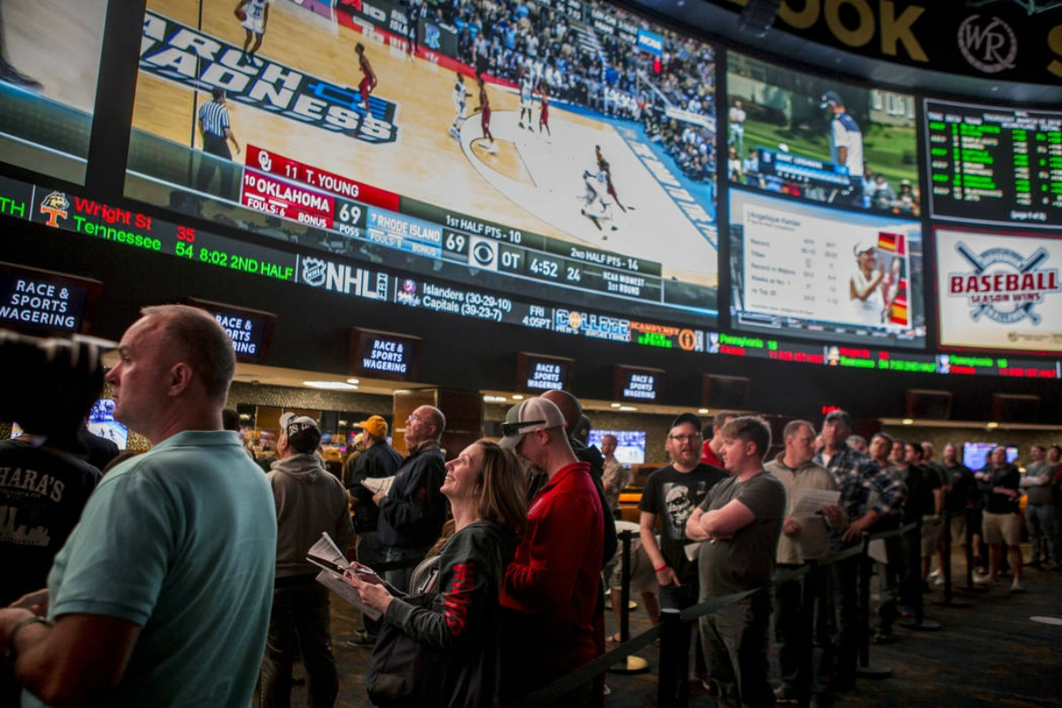
Ethical Conduct, Amateurism, Financial Aid
Gambling-Can’t do it
  ANY sport that the NCAA hosts a championship
    Fantasy Football, March Madness, etc.
    Also includes your own games
  It’s not worth risking your eligibility
Amateurism
  Won any prize money above actual and necessary expenses-Come talk to me
    We want to make sure you are still considered an amateur
Financial aid
  Your financial aid package is from Rockford University
  Outside scholarships may be okay as long as they don’t involved athletics
This Photo by Unknown Author is licensed under CC BY-NC-ND

Slide 5

Transfer Students & International Students
Transfer Students
  Can’t transfer out of trouble
  If you were ineligible at your last school, you may be ineligible with us
    Will meet with each of you individually to go over your tracer report
  Same applies if you want to transfer from RU
    Different types of releases based on where you are looking to go-Come talk to us
International Students
  You have to be deemed eligible from the NCAA Eligibility Center
  You create your account and submit all the information needed then I can track the progress and confirm when/if you are eligible

Slide 6

Paperwork
Any minors in the room?
  A parent or legal guardian have to sign the forms for anyone under the age of 18
    Keep your forms separate and come see me at the end so we can get the forms where they need to go
NCAA Student-Athlete Statement and Drug Testing Consent Combined
  Blue packet
    2026-27 Student Athlete Statement and Drug Testing Consent Combined.pdf
Drug Testing
  Legal in IL doesn’t necessarily mean legal by NCAA; review banned substance list/talk with Athletic Trainers
    2026-27 NCAA Banned Substances.pdf

Slide 7

Enjoy the Year!
Most important rule-Always ask before you act!
  There are a lot of rules and we want to make sure we stay compliant
Welcome again to Rockford University
  We are happy you are here!
  We look forward to a great and successful year!
GO REGENTS!!!

Slide 8

Organization
All of this information is on our athletic website
  https://rockfordregents.com/sports/2023/7/27/compliance.aspx
    It will be updated but you can use this as a reference
Double check you filled out each section
  Signed and dated where you were supposed to
Work with your team to put the packets in alphabetical order based on your last name
  These forms have to be filled out completely, turned in, and reviewed prior to being cleared to practice.
  If you missed any sections or didn’t sign somewhere you won’t be able to start practice and have to come back to finish the form

